Slide 1



health convenience a button away
https://dawa-health.com

Slide 2
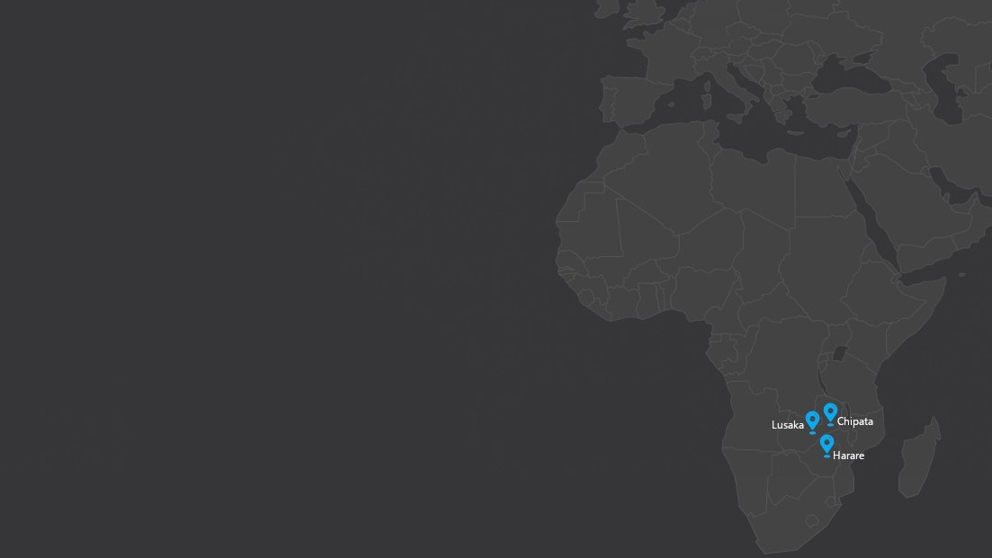

PROBLEM STATEMENT
1.8+ million
(71%)
mothers without antenatal care (ANC)
|annually|
15+
pregnancy-induced daily mortality
55%
mothers in rural communities
source
: www.indexMundi.com
: www.circ.ahajournals.org

Slide 3

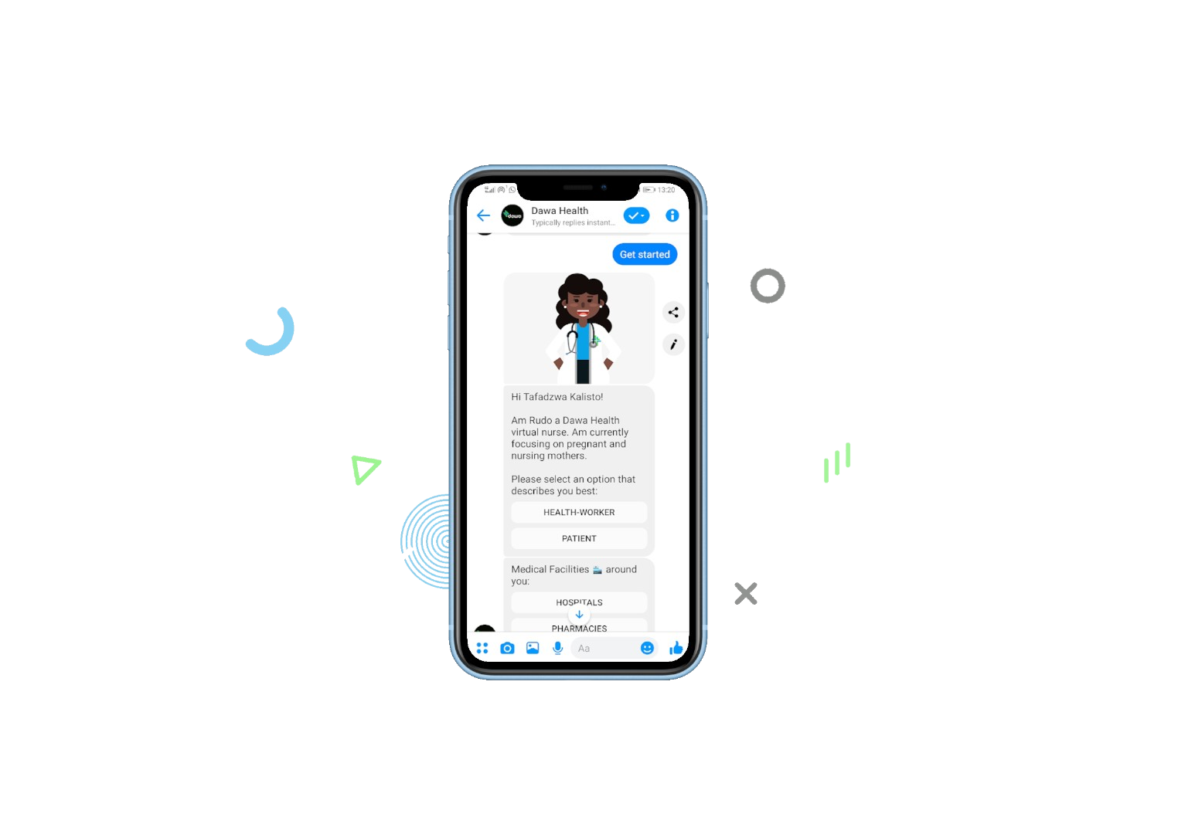
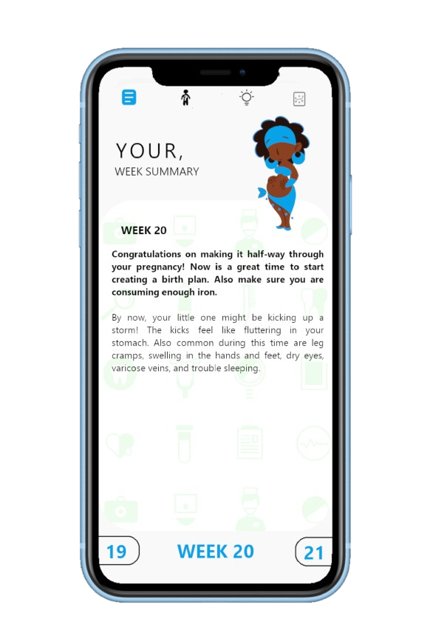
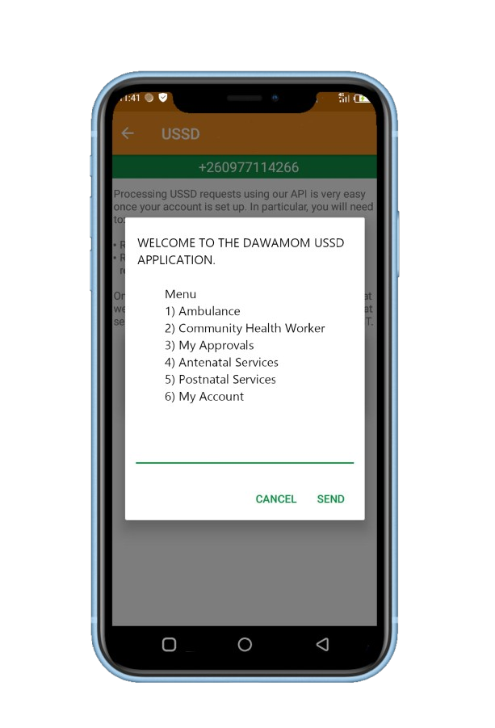






SOLUTION
A digital health platform that’s reshaping access to maternal health for expectant mothers and women needing sustainable contraceptive options.
Secure monitoring of health parameters

Slide 4
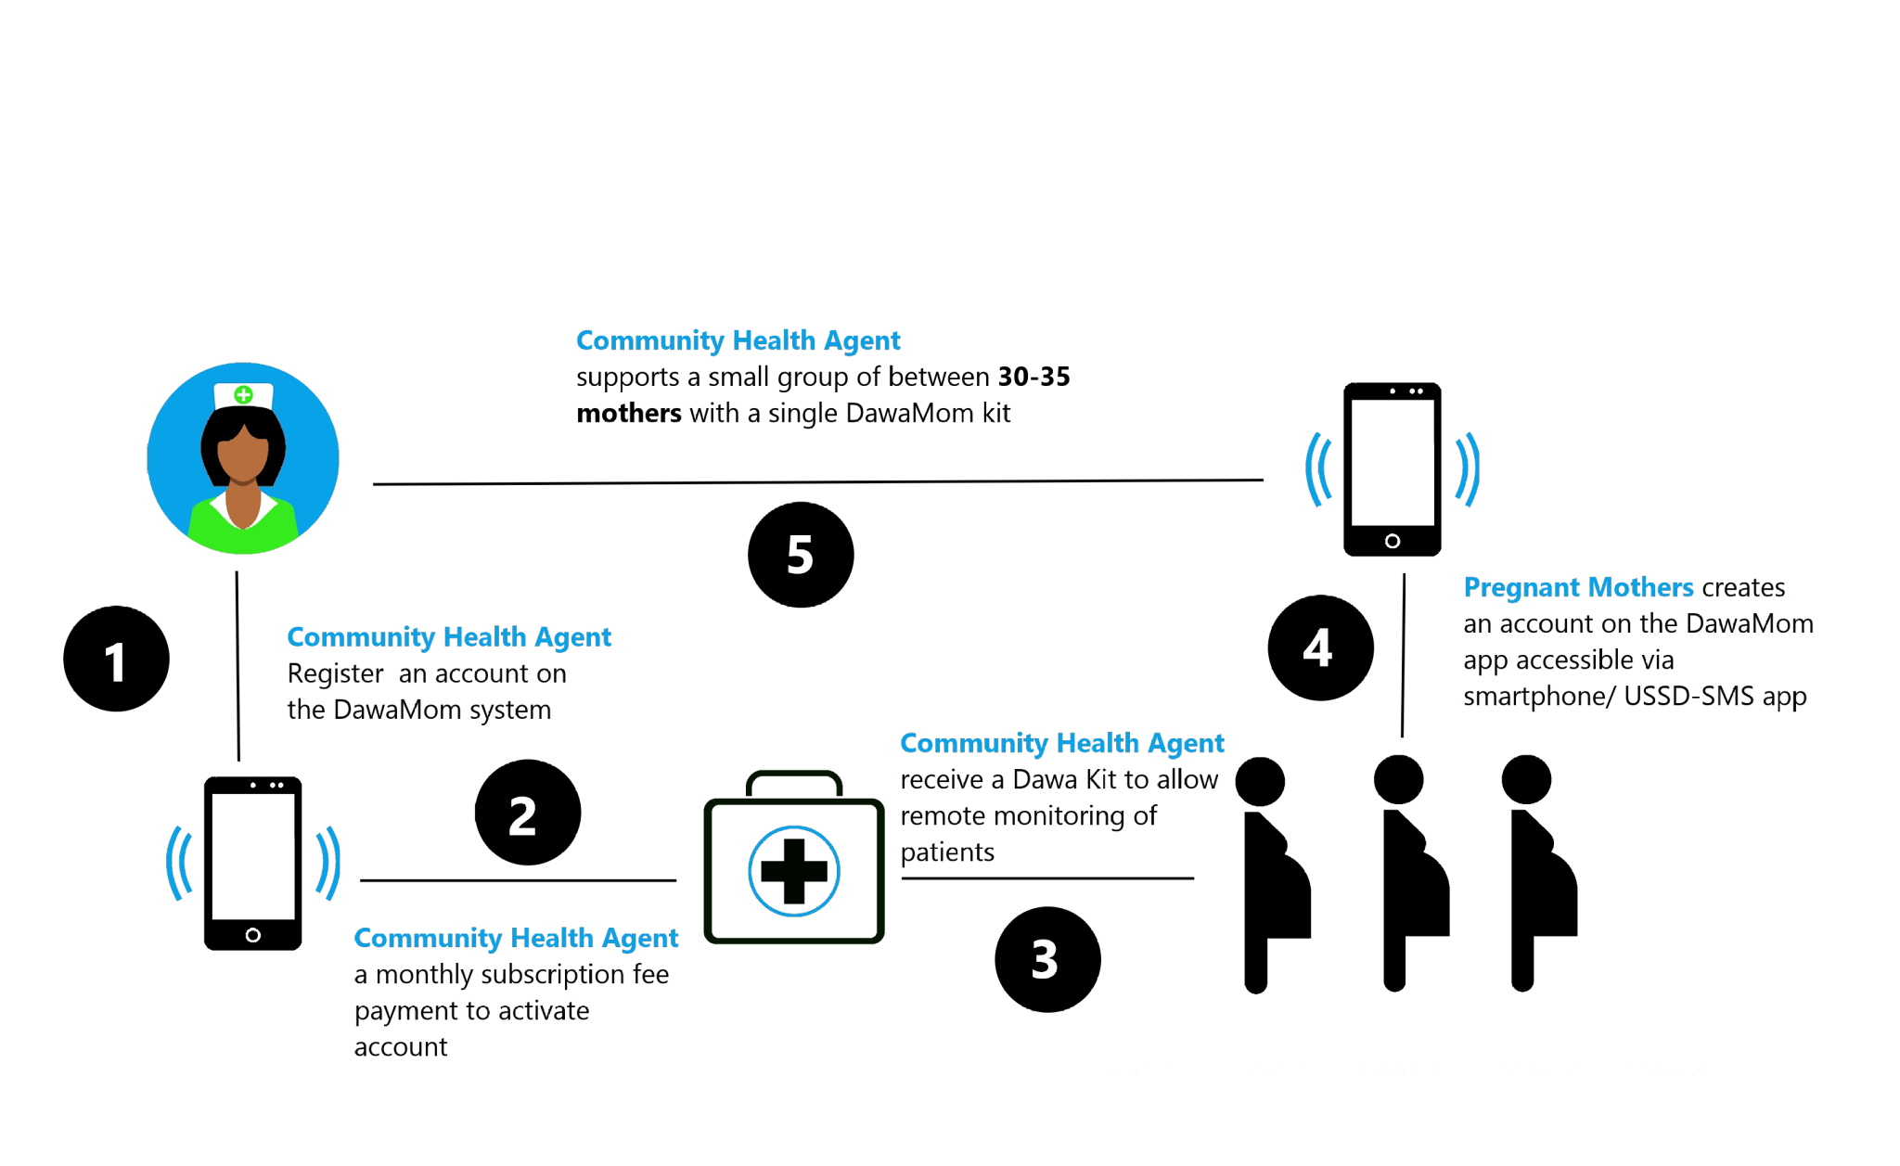
HOW IT WORKS

Slide 5
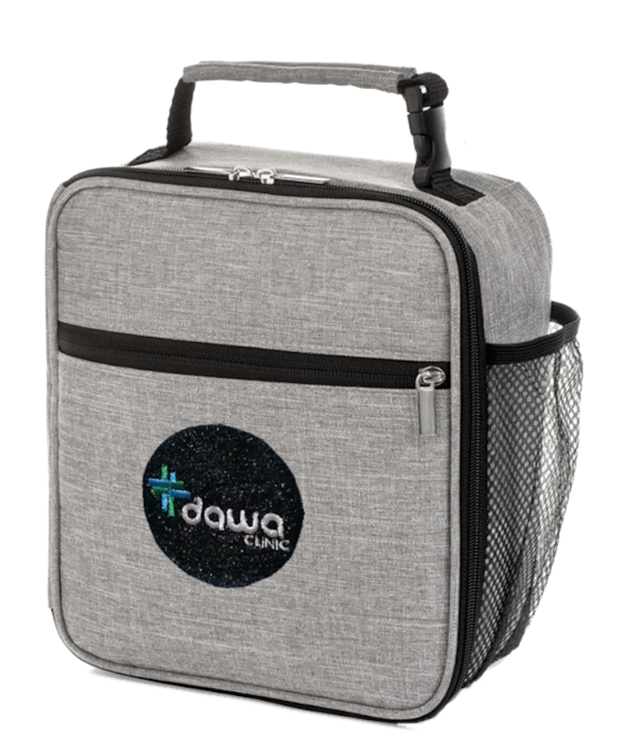
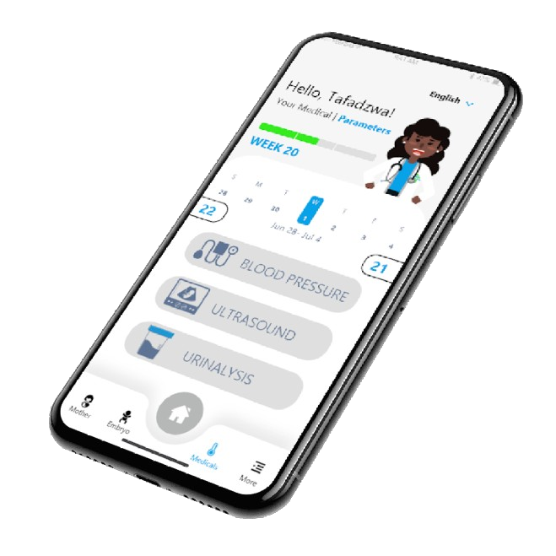
PRODUCT
Products
Services
Timeline
DawaMom app
-tips & action plans
-physiological changes
-baby development
Weekly
BP Machine
- pre-eclampsia
Bi-weekly
Urinalysis Kit
pre-eclampsia
UTIs
Pregnancy-induced diabetes
Bi-weekly
Sayana Press Kit
- 13 weeks fp coverage
Quarterly
Hb Test Kit
- pregnancy induced anemia
Trimesteric
UltraSound Scan Probe
- gynaecology & obstetric scans
First & Last Trimesters

Slide 6
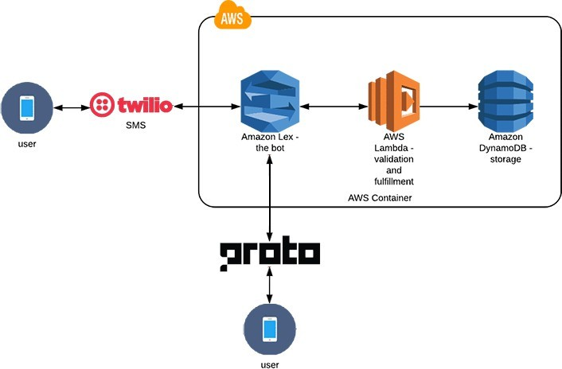
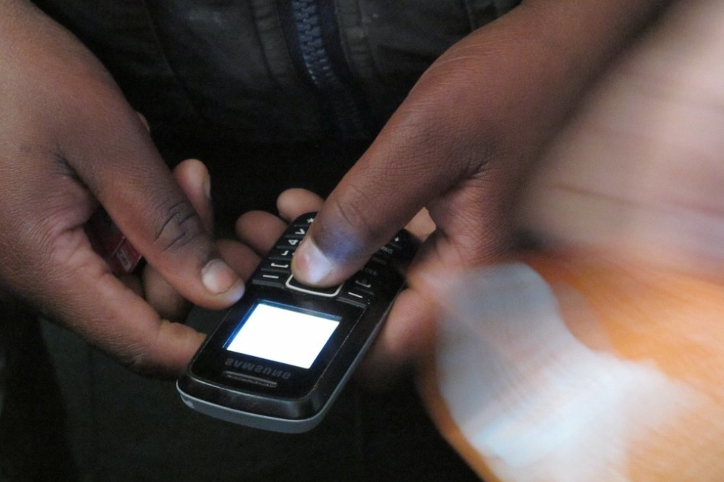
HOW WE ARE USING AI

Slide 7



TRACTION
50+
community health workers
4000+
mothers supported
2
implementation partners

Slide 8
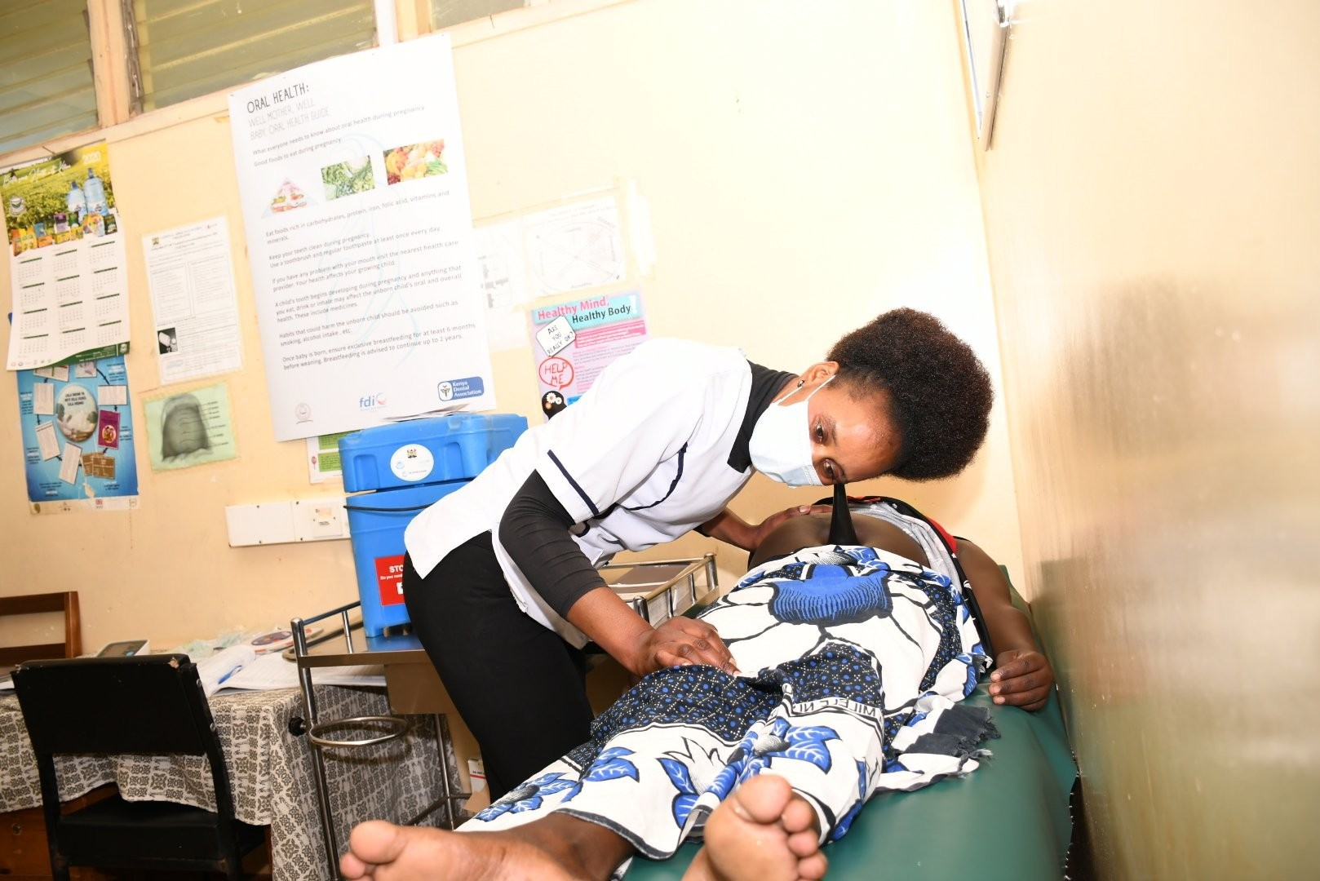




BUSINESS MODEL
B2B2C
DawaMom|CHW US$ 3/month/mother (30% commission)
SayanaPress
US$ 2/dose
Remote UScan
US$ 3/scan
TORCH test
US$ 3/test

Slide 9
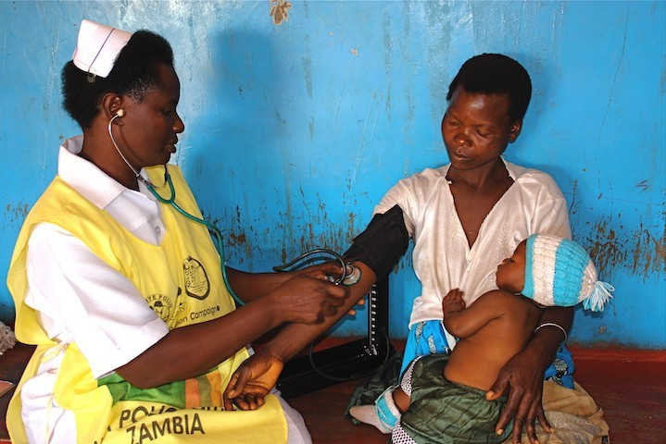
GO-TO-MARKET MODEL
Awareness|Programs
•
•
•
•
Outreach Programs Community Leadership Partner Organizations Community Health Agents
Service|Access
•
•
•
•
Mobile App USSD/SMS app AI-chatbot Web-portal

Slide 10
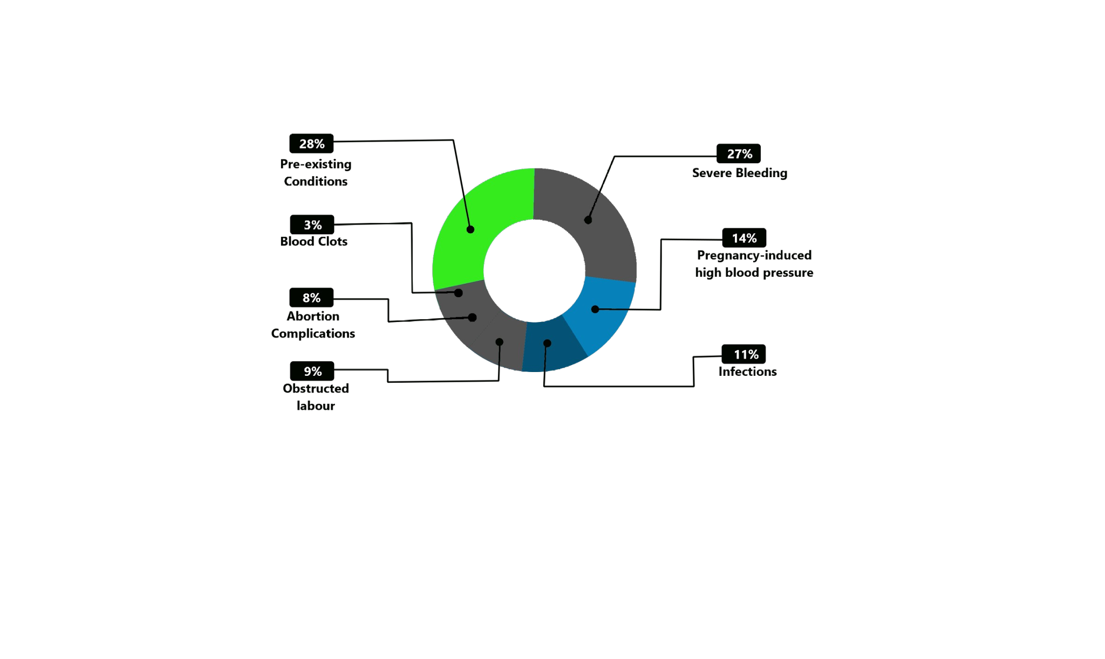
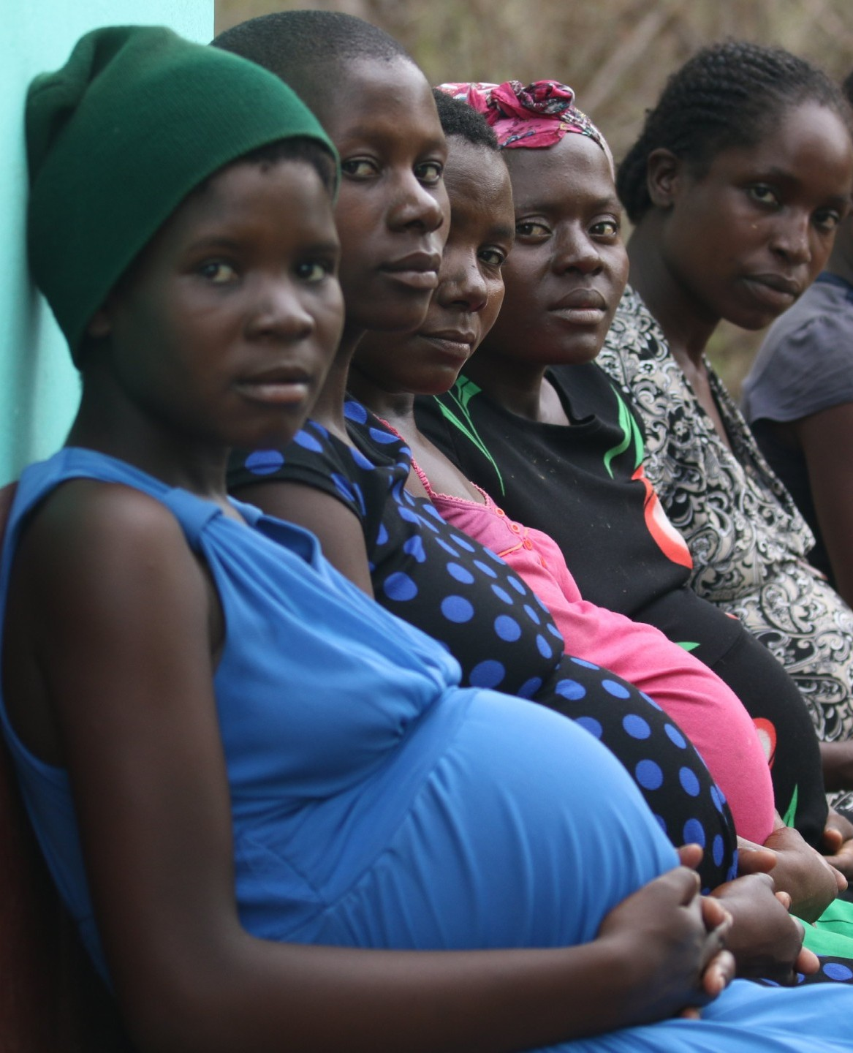
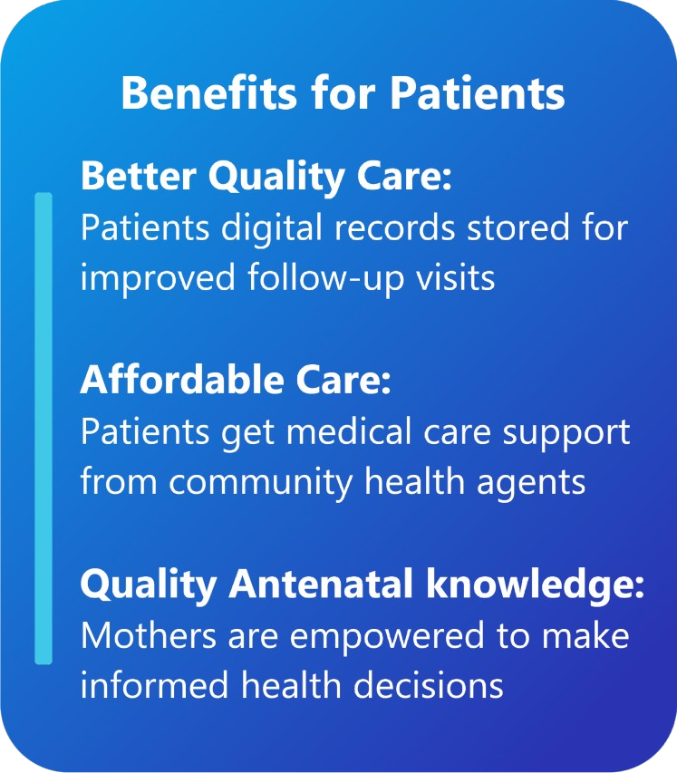
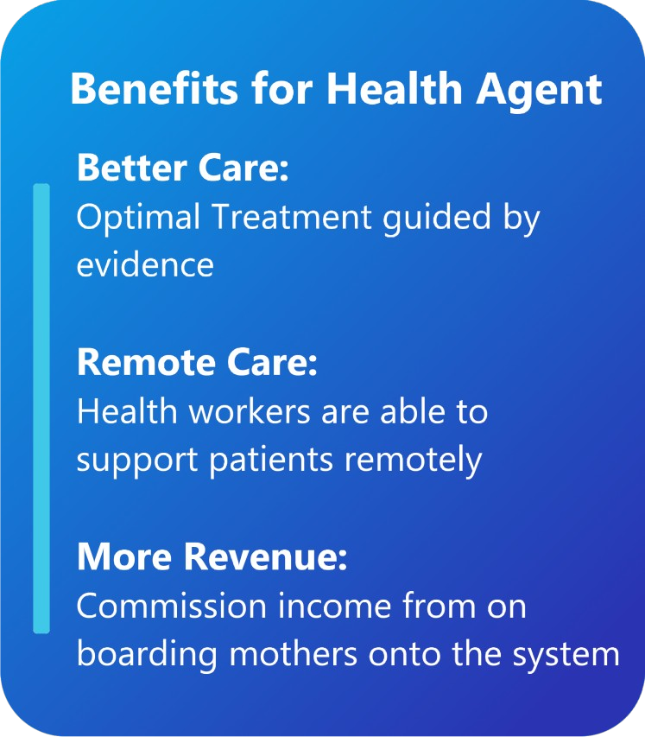
SOCIAL IMPACT
>53%
directly managed
Maternal Mortality Causes

Slide 11
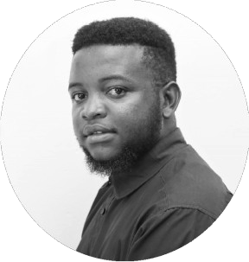
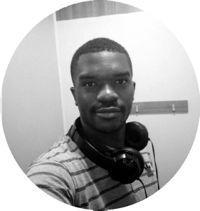
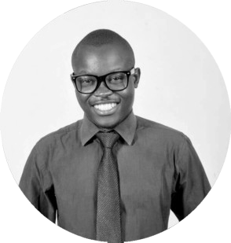
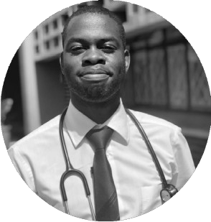
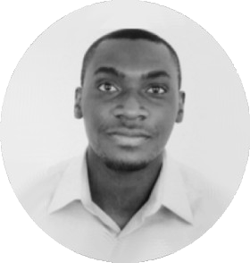
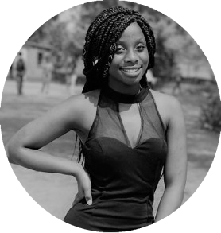
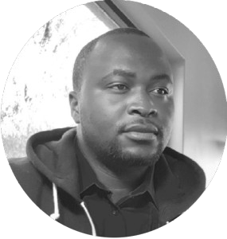

TEAM
Tafadzwa Munzwa CEO
Chungu Chama CTO
Progress Mahureva COO
Takunda Mugwagwa Head of Clinical Care
●
Student Doctor Web Developer
ACT Entrepreneurship| ZICTA ICT innovator| BongoHive Accelerator
●
Full Stack Developer
Huawei Routing and Switching Cisco IT essential
ZICTA ICT innovator|
●
B.Com| Business & Finance First Mutual Health
Old Mutual Group Munch zw
●
Doctor (UBH) CMFZ app lead YALI Network
ARIPO- Cardiology monitor patent pending
●
●
●
●
●
●
●
●
●
●
●
●
●
Aaron Chiwala Junior Associate
Mary Kanawila
Project-manager (Sayana)
Kinsley Kajiva Mobile Dev
Patients Xperience Officer
●
Bsc Economics & Finance Business Development
CMI Level 5- Management & Leadership
CMI Level 5- Data & Information Academic consultant
●
Pharmacist Radio Presenter
Agents of Change Foundation Khupe Girls Leader
●
Bsc Computer Science Fullstack Dev
4+ years of experience AWS Integration Android Expect
●
BA Media & Mass Communicaion Patient Support
Lozi language is a prerequisite Tech Savvy
●
●
●
●
●
●
●
●
●
●
●
●
●
●
ADVISORY
Dr M. K. Lubeya UNZA Medical School Obs & Gynae Specialist
Silumesii Maboshe BongoHive
Elizabeth Harford BongoHive
Kas Shirley Amano Capital Managing Director
Simunza Muyangana BongoHive
Director- Consult
Investment Ventures
Director- Entrepreneurship

Slide 12






















PARTNERSHIPS
GRANTS
INCUBATION SUPPORT
R&D
TECHNICAL/ IMPLEMENTATION

Slide 13
RISK & MANAGEMENT
Risk (description) | Level of Risk | Probability | Mitigation
Community Health Agents | Low | High | Working closely with organizations like UNFPA, ZICTA,
(Low control of direct patient |  |  | and UNDP Accelerator Labs. We have created a robust
support) |  |  | feedback loop direct from the end user to the Dawa
 |  |  | Health team.
Social Structure & Believe | High | High | Working with community health agents & community
Systems |  |  | leaders, the UNFPA technical team, MoH health
 |  |  | centers
Service Accessibility | High | Low | Cloud system on reliable AWS infrastructure.
 |  |  | APIs integrating SMS, WhatsApp, Messenger, Voice.
 |  |  | Planned Data-free app
Covid-19 | High | High | Community health agents follow Covid-19 guidelines
 |  |  | and work closely with health centers
Mobile Phone access | Low | High | MTN smartphone provision proposal for both agents
 |  |  | and mothers. N.B.- To mitigate payment defaults,
 |  |  | agents need commission

Slide 14




KPIs
●
Documented knowledge improvement [Pre-Dawa Project vs Post-Dawa Project]
●
Weekly engagement of each patient on system
●
Total number of expectant mothers + women on Sayana Press kits supported on DawaMom
●
Tests done- blood pressure, Hb tests, urinalysis, UltraSound Scans, TORCH test

Slide 15

ASK
●
Board Members for Dawa Heath structure
●
Network access to partners
●
US$ 300,000

Slide 16
THANK YOU
tafadzwa@dawa.clinic
+260960709572
www.dawa-health.com www.twitter.com/dawa_health www.linkedin.com/company/dawamed

